Slide 1

CSE- 102
Introduction to CS and
Programming Methodology Lab
Lab : 10 Loop: while, do-while
Fahad Ahmed
Lecturer, Dept. of CSE
E-mail: fahadahmed@uap-bd.edu

Slide 2
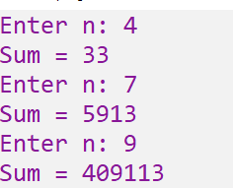
Lab-10 Task
Write a C program for this series and find the result using for loop :
1! + 2! + 3!+ …….…+ n!

Slide 3
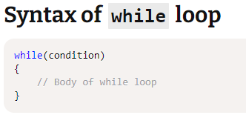
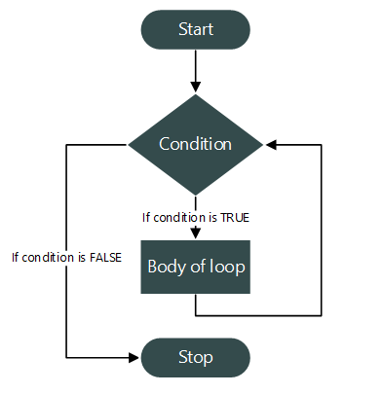
While Loop

Slide 4
While Loop
write a C program to print natural numbers from 1 to 10 using while loop.
#include <stdio.h>
int main()
{
/* Loop counter variable declaration and initialization*/
int n = 1;
/* Loop condition */
while(n <= 10)
{
/* Body of loop */
printf("%d ", n);
/* Update loop counter variable */
n++;
}
return 0;
}

Slide 5
While Loop Practice
C program to print natural numbers in reverse from n to 1
Input
Input N: 10
Output
Natural numbers from 10-1 in reverse: 10, 9, 8, 7, 6, 5, 4, 3, 2, 1

Slide 6
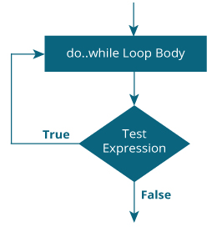
do...while loop

Slide 7
do...while loop
do {
// statements inside the body of the loop
} while (testExpression);

Slide 8
do...while loop
While vs do..while loop in C
Using do while loop:
Using while loop:
#include <stdio.h>
int main()
{
int i=0;
while(i==1)
{
printf("inside loop\n");
}
printf("Out of loop");
}
#include <stdio.h>
int main()
{
int i=0;
do
{
printf("inside loop\n");
}while(i==1);
printf("Out of loop");
}

Slide 9
Loop Practice-01
Program to count total digits in a given integer using loop

Slide 10
Loop Practice-02
C program to find sum of digits of a number
Input
Input any number: 1234
Output
Sum of digits: 10

Slide 11
Loop Practice-03
C program to find reverse of a number
Input
Input number: 12345
Output
Reverse of 12345 = 54321

Slide 12
Loop Practice-04
C program to check whether a number is palindrome or not
Input
Input any number: 121
Output
121 is palindrome

Slide 13
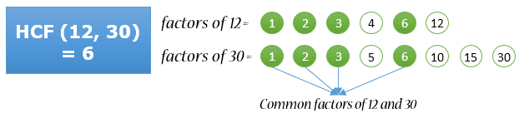
Loop Practice-05
C program to find HCF (GCD) of two numbers
Input
Input first number: 12
Input second number: 30
Output
HCF of 12 and 30: 6

Slide 14
Loop Practice-06
C program to check whether a number is armstrong number or not
Input
Input number: 371
Output
371 is armstrong number

Slide 15
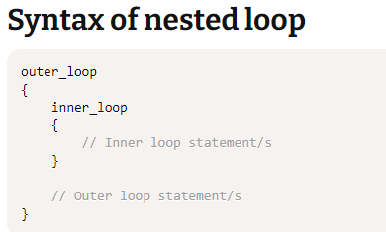
Nested loops in C programming

Slide 16
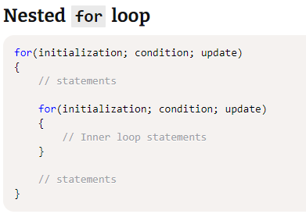
Nested loops in C programming

Slide 17
Loop Practice-07
C program to print all prime numbers between n to m
Input
Input lower limit: 1
Input upper limit: 20
Output
Prime numbers between 1-20: 2, 3, 5, 7, 13, 17, 19

Slide 18
Lab Schedule
10-Oct-2020 - 8.30 AM- 11.00 AM
Lab-Final
17-Oct-2020 - 3.00 PM- until end

Slide 19

Thanks to All

